Slide 1
ADVANCMENTS IN CONCUSSION MANAGEMENT
Dr Matthew Petznick D.O
Board Certified Sports Medicine
Board Certified Family Medicine

Slide 2
OBJECTIVES
UNDERSTAND THE CURRENT HYPOTHESIS OF CONCUSSION PATHOPHYSIOLOGY
GAIN THE ABILITY TO DIAGNOSE AND PREDICT PROTRACTED RECOVERY
UNDERSTAND CONCEPTS IN CONCUSSION RECOVERY AND TREATMENT

Slide 3
HOW DID WE GET HERE

Slide 4
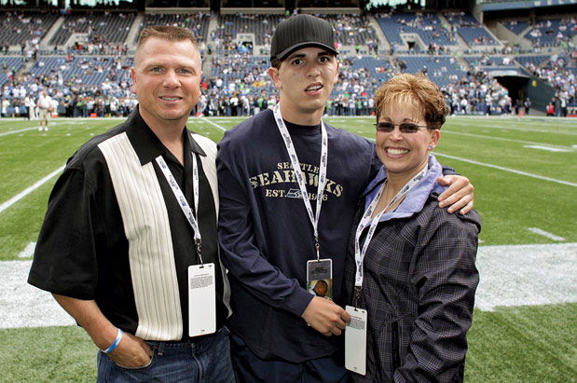
ZACHERY LYSTEDT
Notes:
mTBI- no structural damage on MRI and CT
TBI- skull fracture, cerebral hemorrhage, subarachnoid hemorrhage, subdural, epidural

Slide 5
ZACHERY’S STORY
2006 in Junior High School
Multiple concussions in one game
Sustained Second Impact Syndrome during a game
Left with significant comorbidities
  7 days life support
  Unable to speak for 9 months
  2 years of feeding tube
May 16, 2009 first state to pass Lystedt Law
  Washington State

Slide 6

PLAY THAT CHANGED EVERYTHING

Slide 7
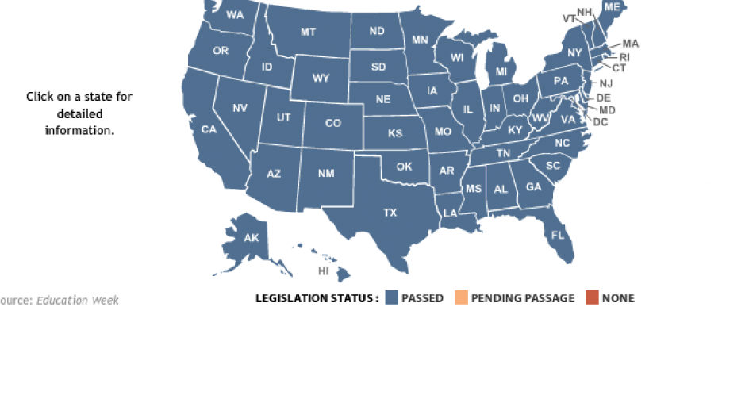
CURRENT LAWS PASSED

Slide 8
OHIO LAW
Ohio Bill 143
April 26, 2013
Online training for Coaches and referees
Information provided to parents
No return to sport same day of diagnosis/suspected of concussion
MD or DO for clearance

Slide 9

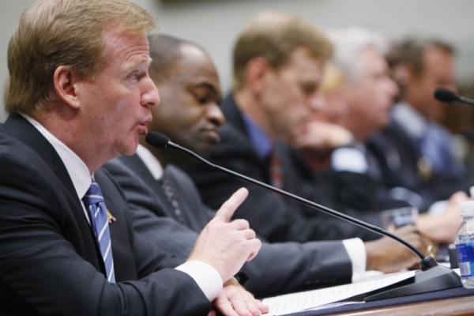
NFL making changes
Commissioner before Congressional committee in Oct 2009
NFL’s response since that time:
  No RTP same game in most cases
  Independent doctor clearance

Slide 10

NCAA Follows NFL Lead
December 2010
  NCAA now making changes in response to what NFL has done
    No return to play same day of concussion
    Must be cleared my doctor

Slide 11
HEIGHTENED AWARENESS

Slide 12

INCREASING PROBLEM?
More education
  CDC- Heads Up
  Coaches and Referees
Media
  Local
  National
Better physicians

Slide 13
STATISTICS
1.6-3.8 million concussions a year (kutcher 2010 sports health)
5-9% of all sports related injuries (AMSSM)
As many of 50% go unreported (AMSSM position statement 2012)
2-5.8 x increase risk of another concussion

Slide 14
KNOWLEDGE

Slide 15
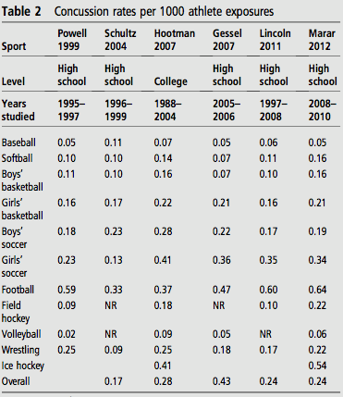
CONCUSSION RATES PER SPORTS

Slide 16
Knowledge
Professional
Collegiate
Youth
High school

Slide 17
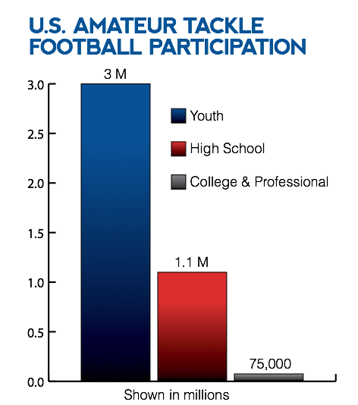

Slide 18
YOUNGER NOT ALWAYS BETTER
Days
Covassin et al 2012
Notes:
21 vs 7
10-21 d v 5-7 days

Slide 19
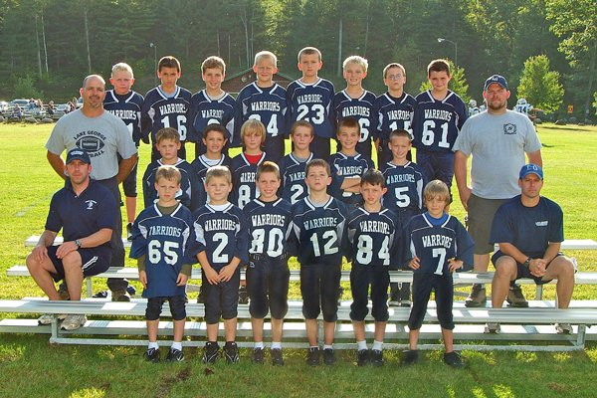
IS STARTING YOUNG APPROPRIATE
Proper Training- skills gained
Exposure game situations
Team building

Slide 20
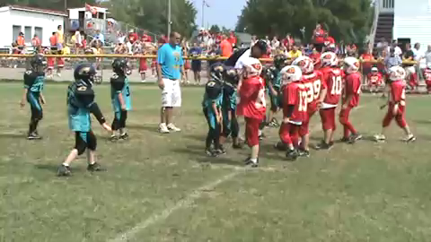
YOUTH FOOTBALL

Slide 21
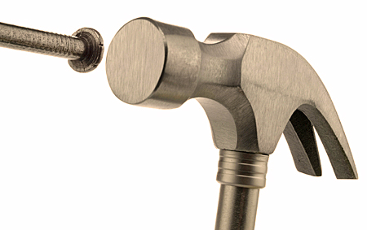
Hammer or the Nail?
Vianno 2007
 | Linear acceleration (g) | Rotational acceleration (rad/sec²)
Struck | 94 | 6432
Striking | 46.8 | 3983

Slide 22
PATHOPHYSIOLOGY of
CONCUSSION
Notes:
Energy crisis and mitochondrial dysfunction
Lateral fluid percussion wave (rats)

Slide 23
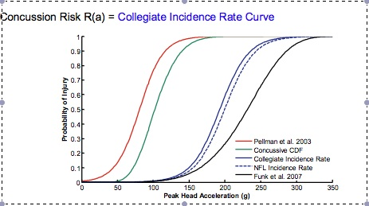
FORCES TO CAUSES CONCUSSION
VT Helmet Study
http://www.sbes.vt.edu/nid.php

Slide 24
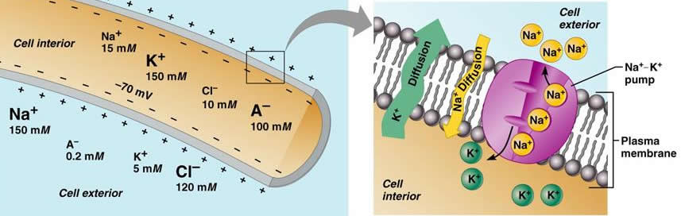
NORMAL AXON GRADIENT
Notes:
Normal gradient

Slide 25
LEADING HYPOTHESIS
Injury
Rotational deformity leading to membrane deformation
Nerve
Na+ moves into cell, K+ out
Random Depolarization
Spreading depression
Glutamate release (excitatory NT) – binds to NMDAr causing calcium to accumulate
Ca++ increases inside cell
Miss-Match
Decrease blood flow and unable to re-establish gradient
more glutamate release
Pressure wave
No glucose
Mitochondrial dysfunction (calcium overload)
Rely on glycolysis
Notes:
Glutamate causes more depolarization and channels for calcium to accumulated into the cell by NDMA receptor
Calcium overload leading mitochondral dysfunction unable to produce energy accumulation of ROS
Alter PH which also leads to mitochondrial dysfunction (d/t calcium over load and ROS accumulation unable to produce ATP effectively)

Slide 26
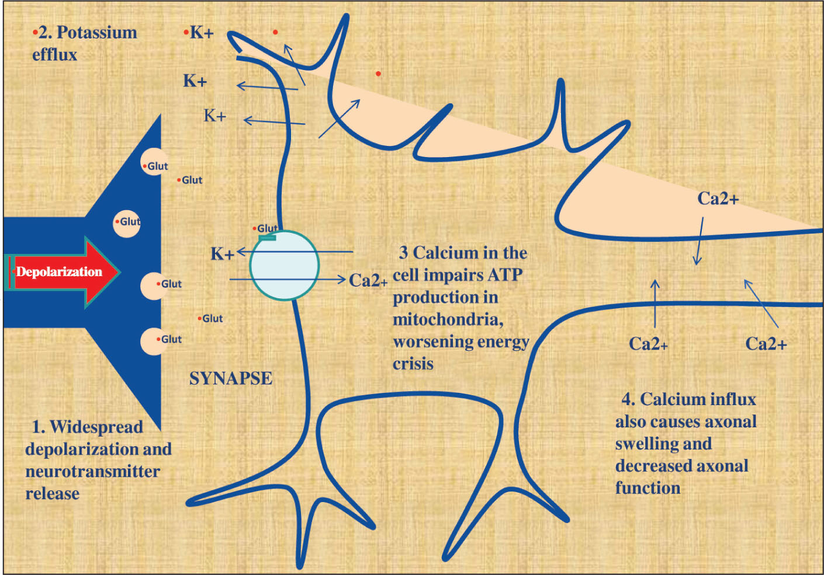

Slide 27
ON-FIELD PRESENTATION

Slide 28
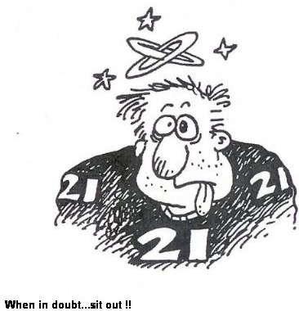
SYMPTOMS
HA (MC)
Fogginess
Dizzy
Nausea
Amnesia
LOC <10%
Change mood
Confusion
Vision issues

Slide 29
ON-FIELD SYMPTOM
Dizziness
  Highest predicted symptoms for protracted recovery (>10 days)
LOC and amnesia, confusion, vomiting not significant predictor
Lau, Kontos, Collins 2011 AJSM

Slide 30
MALES VS FEMALES
Female
Greater area of unmyelinated neurons
Male
Cognitive symptoms
Stronger necks
Higher CBF and metabolic rate which may exacerbate neurometabolic crisis
+/- estrogen effect
Somatic complaints (headaches)
Larger head/ball ratio
Covassin et al Transl. Stroke Res. 2013

Slide 31
OFFICE SETTING

Slide 32
Comprehensive Approach
Interview
Physical exam
Vestibular-ocular exam
Neurocognitive testing
CONCUSSION

Slide 33
INTERVIEW
Detailed
PHMx:
  Migraines, LD/ADHD, prior concussions, grades, motion sickness, etc
FHX:
  History of migraines
  Memory issues

Slide 34
FIRST WEEK AFTER CONCUSSION
Cognitive difficulties, vision problems, fatigue
Sleep issues, MSK compliants
Headaches, post-traumatic migraines
CONCUSSION
Kontos et al 2012 AJSM
Notes:
Kontos, elbin, schatz collins ajsm 2012

Slide 36
4 SUBSETS OF SYMPTOMS
CONCUSSION SYMPTOMS: HA, fatigue, sleep, MSK, balance issues, etc
Sleep
Cognitive
Psych Issues
Headache/PTM
Collins et al 2013 Applied Neuropsych.

Slide 37
SYMPTOM PREDICTORS
Headache, nausea, photo/phonophobia 7.29 odds ratio of protracted outcome vs no headache (kontos AJSM)
PTM protracted outcome when compared to HA
Fogginess (LAU 2009 CJSM)
DIZZINESS
PTM
PROTRACTED OUTCOME
FOGGINESS
Notes:
PTM 2.6 x more likley >20 when compared to HA

Slide 38
BIOMARKERS

Slide 39
BIOMARKERS
Neuron Proteins:
  Neuron Specific Enolase
  Cleaved Tau proteins
Glial Cells:
  S-100
  CKBB
  Glial fibrillary acidic protein
  Myelin basic protein
Biomarkers, Genetics, Risk factors for concussion PMR 2011

Slide 40
EXAM
Neurologic exam
  Cranial nerves
  Memory
  BESS Testing
Vestibular ocular system
  Accommodative insufficiency
  Convergence insufficiency
  VOR
    Keep images in the center of the retina
Musculoskeletal system

Slide 42
Vestibular-Ocular Screening
Ocular:
  Smooth pursuits
  Saccades- horizontal, vertical
  Convergence
  Accommodation
Vestibular:
  Vestibular ocular reflex- horizontal, vertical
  Cytokinetic screening

Slide 43



NEUROCOGNITIVE TESTING

Slide 44
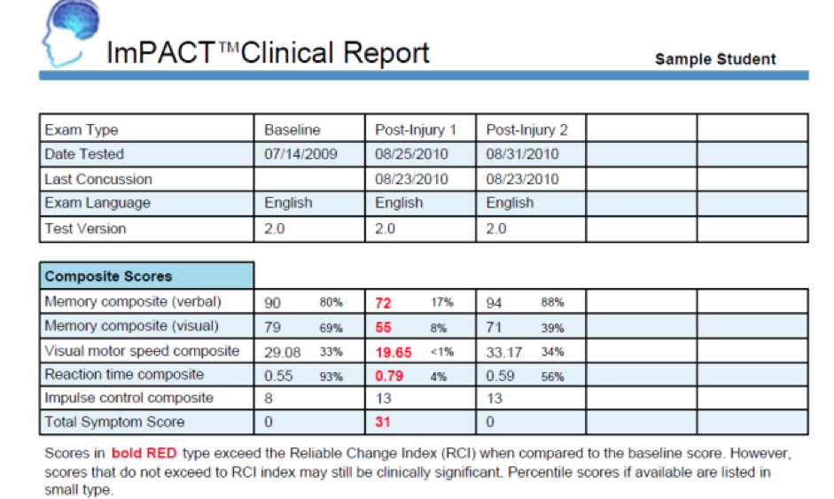
Notes:
3 out of 4 RCI then 94% >10 days

Slide 45
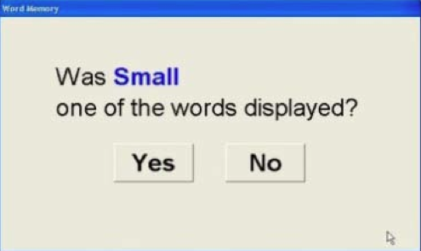
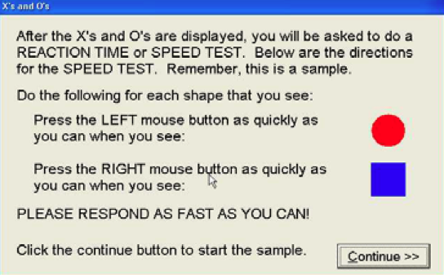
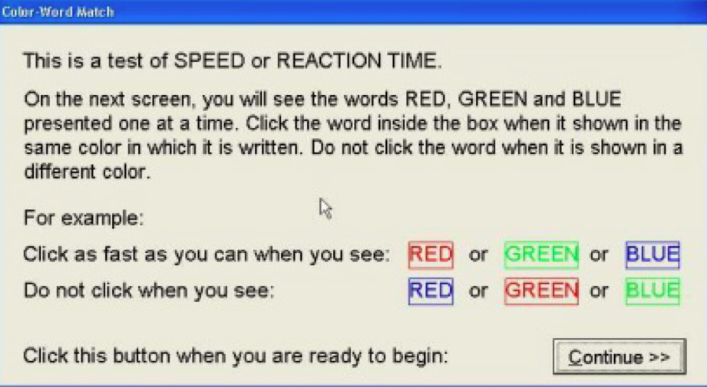
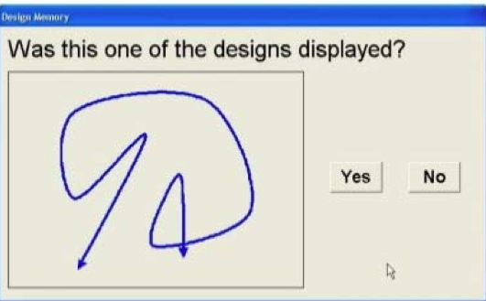
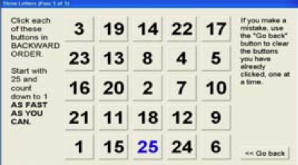

Slide 46
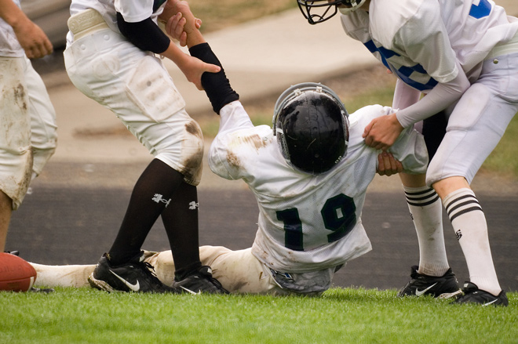
DIZZINESS
PTM
PROTRACTED OUTCOME
FOGGINESS
NEUROCOGNITIVE DATA

Slide 47
TREATMENT

Slide 48
CONCUSSION SYMPTOMS: HA, fatigue, sleep, MSK, balance issues, etc
Sleep
Cognitive
Psych Issues
Headache/PTM
Vestibular/Ocular
MSK

Slide 49
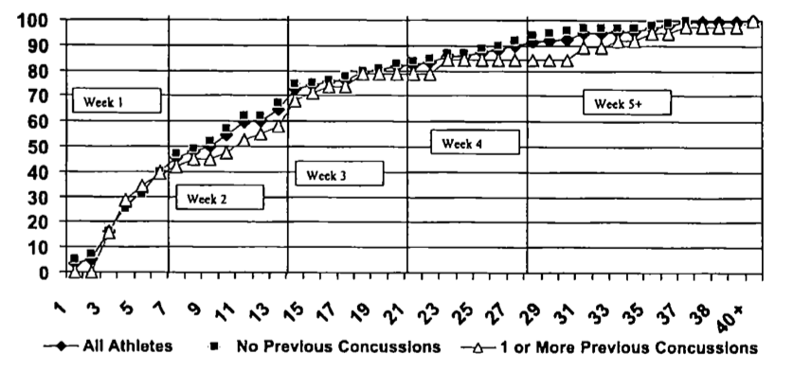
RECOVERY AVERAGES
80% recovery in 3 weeks
20% >3 weeks (prolong recovery)
Reddy, Collins 2009

Slide 50
POST-TRAUMATIC MIGRAINE

Slide 51
Post-Traumatic Migraine
Most common symptom reported from concussion
Can at times be delayed (bus ride home)
Will worsen with physical and mental activity
Always think of other causes- cervical, vestibular-ocular, rebound medication

Slide 52
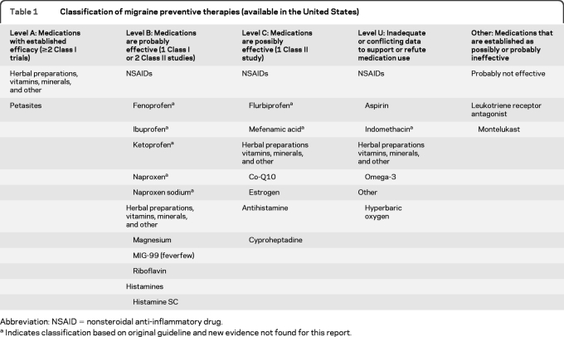
PTM Treatments
Vitamins
  Magnesium oxide 500 mg daily
  Vitamin B2 (riboflavin) 200-400 mg daily
  Omega fatty acids (2-4 grams daily)

Slide 53
PTM Treatment
Abortive- triptans
Preventive
  Antidepressants
    Amitriptyline 10-30 mg
    Venlafaxine
    Sertaline
  Anticonvulsants
    Topamax, valproic acid
  Beta-blockers
    Use if unable to use antidepressants

Slide 54
COGNITIVE

Slide 55
COGNITIVE
Think of when headaches progress/worsen as day progresses
Fogginess, concentration, school issues
Trying to increase dopaminergic transmission

Slide 56
MEDICATION
Amantadine:
  100 mg qd 5 days then bid with meals
  Must wean off
  Efficacy of Amantadine Journal of head trauma 2013
    25 athletes; protracted recovery
    Looked at ImPACT data as end point (3-4 weeks)
Methyphendiate
  Recommended for treatment of attention and processing speed (Meehan clinic of sports med 2011)

Slide 57
MOOD ISSUES

Slide 58
Mood Problems
Depression/Anxiety
  Sadness (removal from playing)
  Stress about the future
  Not active
Psychotherapy
Anti-depressants
  SSRIs
  Amitriptyline
  SNRIs
Benzo’s
  Klonopin (vestibular component)

Slide 59
SLEEP ISSUES

Slide 60
Sleep Disturbances
Problems staying asleep (thoughts, HA), initiating sleep
Think about environment
Schedule of sleep- sleep hygiene
Medication
  Anti-depressants (amitriptyline)
  Melatonin- 3-5 mg qhs
  Anti-histamine SE
  Non-benzodiazepine

Slide 61
VESTIUBULAR

Slide 62
Vestibular
Dizziness, fogginess, feeling detached, motion discomfort, problems in crowded moving places, Problems in moving crowds heights
Optokinetic hypersensitivity
Balance= vision, somatic, vestibular
Bess scoring
  Tends to recover quicker in concussion than other concussive symptoms

Slide 63
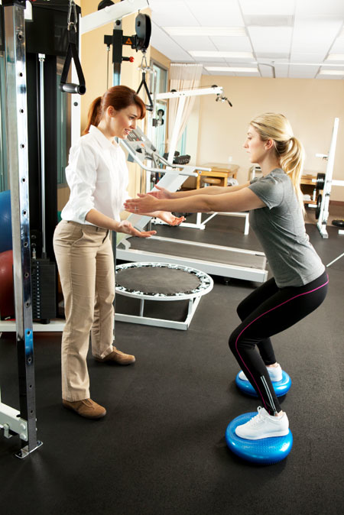
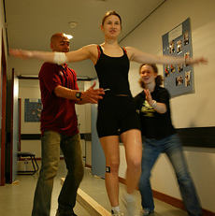
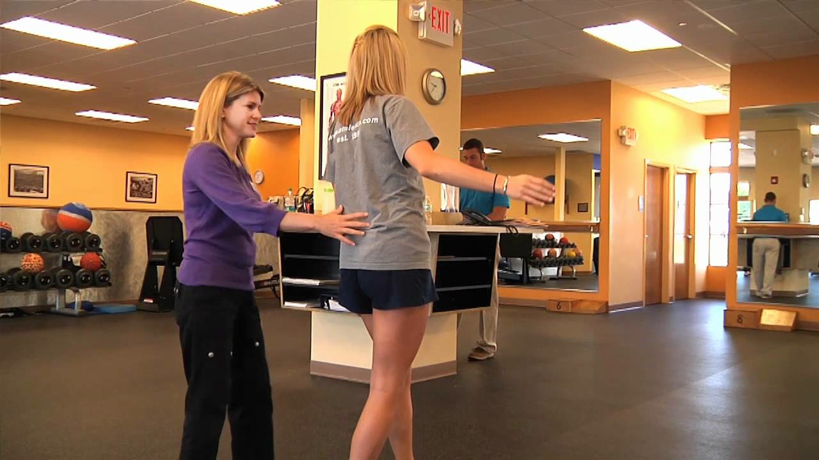

Slide 64

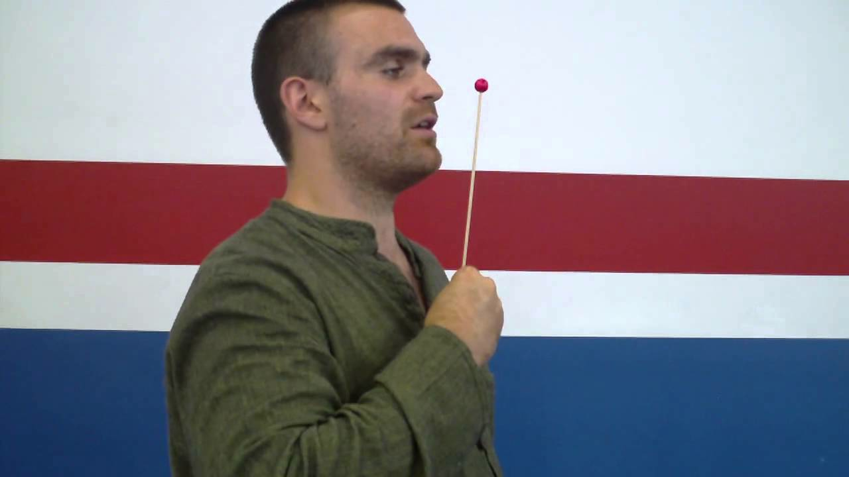
Ocular
Blurry vision, reading/math problems (subjects that require visual aspect)
Smooth pursuits, saccades, accommodation, convergence

Slide 65
RETURN TO PLAY

Slide 67
HOW MANY IS TOO MANY

Slide 68
HOW MANY IS TOO MANY
Prior concussion possibly lower threshold for future concussions
  2-5.8 x risk for subsequent concussions
>2 concussion demonstrate longer return to baseline then history of athlete with 1 concussion (elbin et al 2013 transl. stroke res.)
Prior history of concussions leads to decrease NCT
>2 concussions higher number of baseline symptoms
Neuroimaging return to baseline about 30 days (N acetyelasparate) (Zafonate JAMA 2011)

Slide 69
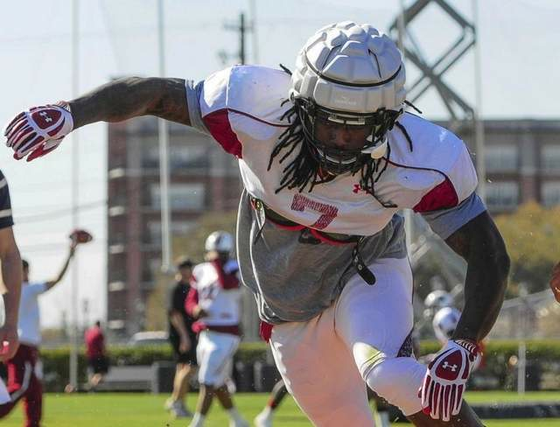
PREVENTION
NOTHING HAS BEEN PROVEN TO PREVENT CONUSSION
Helmets/helmet add-ons
  Protect skull fracture
Mouth guards:
  Dental protection

Slide 70

THANK YOU
QUESTIONS?

